Slide 1
Geostatistics
Getting started with R
Ir. Milkias SEMEREAB

Slide 2
Lecture Outline
A brief introduction to R programing language
R and Rstudio Installation
R Operators
R basic data types
R data structures
Functions
Slight touch to packages
Representing data in useful manner
Hands on R
Geostatistics

Slide 3

What is R ?
R is a language and environment for statistical computing and graphics, is similar to the S language and environment.
R provides a wide variety of statistical (linear and nonlinear modelling, classical statistical tests, time-series analysis, classification, clustering, …) and graphical techniques, and is highly extensible.
Well-designed publication-quality plots can be produced, including mathematical symbols and formulae
R is available as a Free Software
Software and object-oriented language
Geostatistics

Slide 4
Why R is interesting for us?
R is an interpreted language, not a compiled one, meaning that all commands typed on the keyboard are directly executed without requiring to build a complete program like in most computer languages (C, Fortran, Java, ).
RStudio playing role in popularity of R.
R is high level language.
R's syntax is very simple and intuitive.
R manual/Documentation
R packages. E.g., R+gstat as the only complete and fully-operational package for geostatistical computing.
Very active R community
Stackoverflow
R-bloggers etc.
Geostatistics

Slide 5
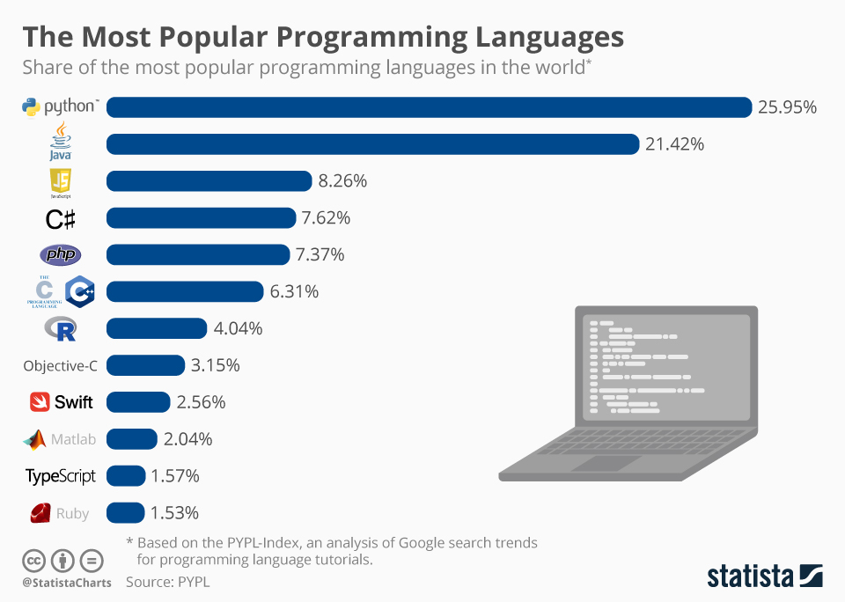
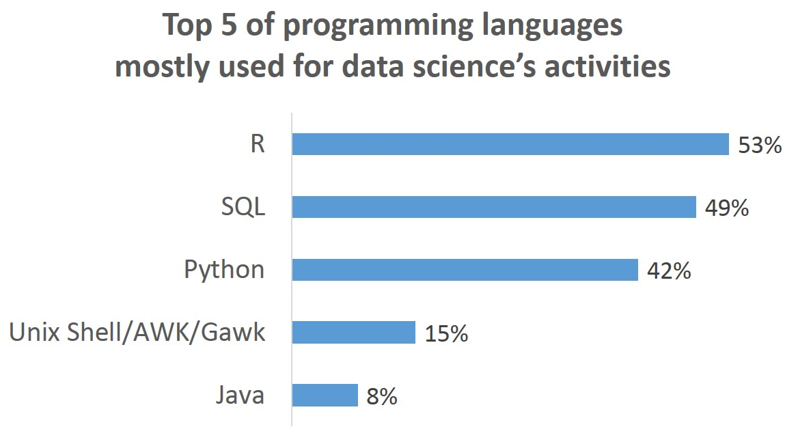
Popularity of R
https://www.statista.com/chart/16567/popular-programming-languages/
Geostatistics
https://www.datasciencecentral.com/top-programming-languages-for-data-science-first-partial-survey/

Slide 6
R and Rstudio
Download the version of R appropriate for your computer
https://cran.r-project.org/
RStudio is a set of integrated tools designed to help you be more productive with R. It includes;
A console
Syntax-highlighting editor that supports direct code execution
Variety of robust tools for plotting, viewing history, debugging and managing your workspace.
Download R Studio Desktop
https://rstudio.com/products/rstudio/download/
Geostatistics

Slide 7
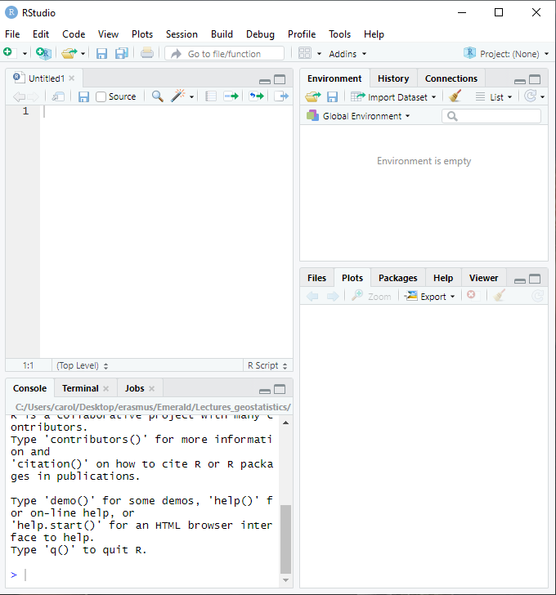
Rstudio Windows
3. Workspace &
History
1. Code Editor
(script window)
4. Plots, packages &
Files window
2. R Console

Slide 8
R as calculator
>6*6
[1] 36
>6/3
[1] 2
sqrt (100)
[1] 10
>(3+5)*(6-7)/(6*6+7)
>sqrt(9)
>4^2
>log(2)
>exp(6)
Geostatistics

Slide 9
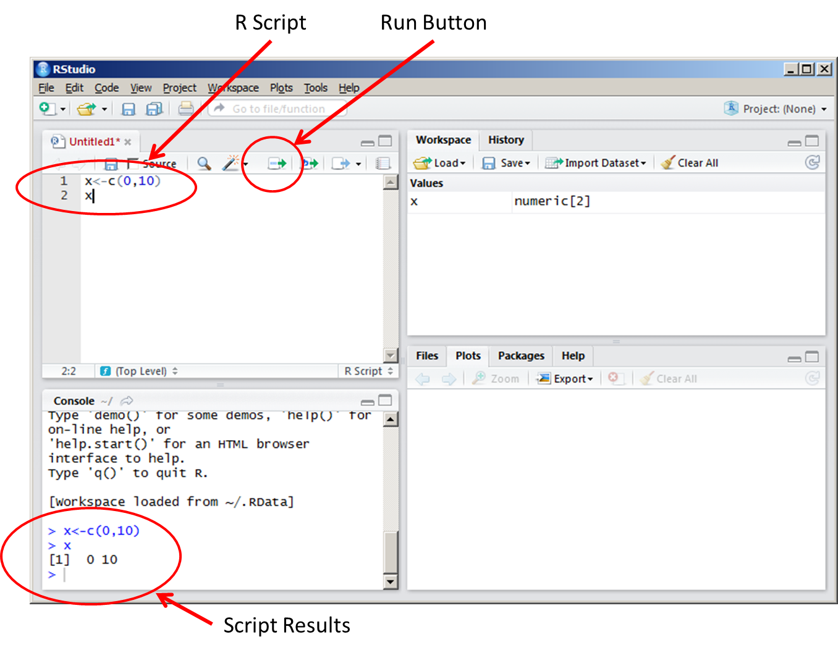
Rstudio Windows: Running code in script vs console.
When running the code directly in the console, it isn't saved for being reproduced further. If we need (and we usually do) to write a reproducible code to solve a specific task, we have to write and save it in a script file rather than in the console.

Slide 10
Variable Assignment
We assign values to variables with the assignment operator "=". We should note that another form of assignment operator "<-" is also in use.
Note: Variable assignment is not same as equality !
> x = 5
> x
[1] 5
> y <- 7
> y
[1] 7

Slide 11
Basic Data types in R
Numeric
Integer
Logical
Character
Complex

Slide 12
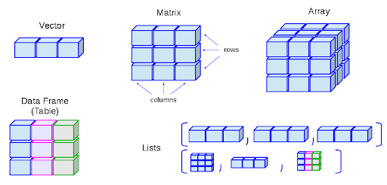
From R data type to R Data structures
Geostatistics
Notes:
“plot3D” - Draws a 3D scatterplot, visualising 2-D and 3-D data.
“fields” - For curve, surface and function fitting with emphasis on spatial data, geostatistics and spatial statistics.
“lattice” - Improve the graphics by providing better defaults and the ability to easily display multivariate relationships
“corrplot” - graphical display of a correlation matrix

